Slide 1

PWP System User Guide.
PWP System has three Users:
Users.
Administrator.
Guest.

Slide 2

HELP PER PAGE.
NOTE
PWP System incorporates help for every page, if you are stuck when using the PWP System, click on this to get help for that page. Each page has its respective help.

Slide 3
INDEX PAGE.
Within the Index Page, All the system users are required to provide the credentials needed, to access any System resource. i.e. username and password.
After Entering this, then press log in button.

Slide 4
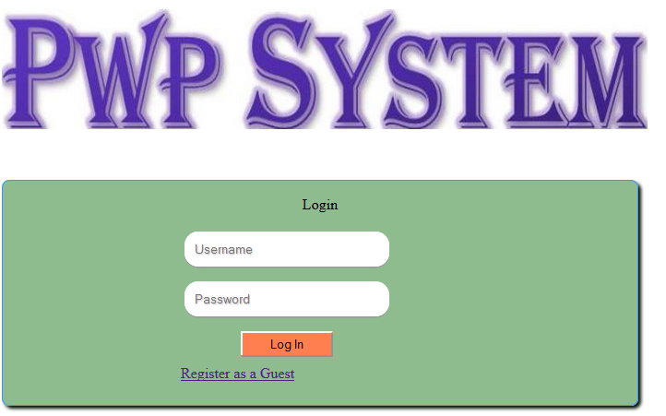
INDEX PAGE.
Enter Username.
Enter Password.
Click Here to register as a guest.

Slide 5
user's MENU
The Following are the items within the clerk’s Menu:
i. Healthy Facility.
ii. Groups.
iii. Providers.
iv. Clients.
v. Attendance.
vi. Management.
vii. Reports.
viii. Log Out.

Slide 6
user’s Menu
Move A mouse over any of the following item to view a sub-menu
Create Back up, edit your details, get help
Add or edit groups details
Add or edit clients details
Log Out.
Add or edit service provider details
Add or edit Health facilities
Mark or edit attendance
Generate System Reports

Slide 7
Administrator’s Menu
Move A mouse over any of the following item to view a sub-menu
Add Or Edit User’s Details.
Add or edit Service Provider details.
Mark or Edit Attendance.
Generate System Reports.
Add or edit healthy facilities and groups.
Add or edit Clients.
Manage Data, Edit Your Details and Get Help.
Log Out.

Slide 8
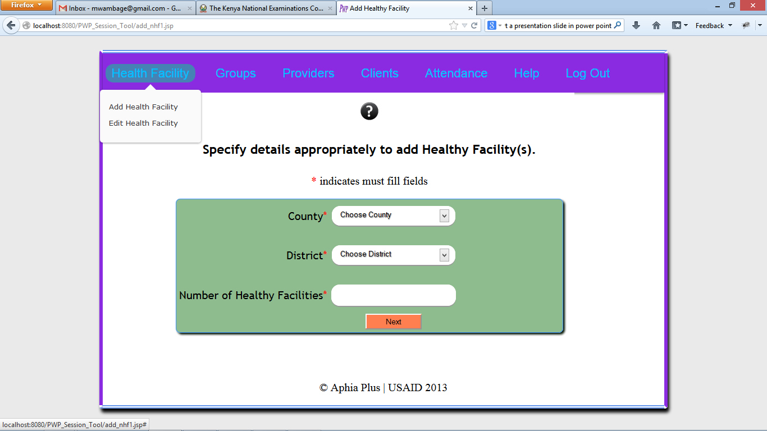
health FACILITY
If a mouse is moved over this item, the following sub-menu appears.
Click Here to add a new Health Facility
Click Here to edit existing Health Facility’s Details

Slide 9
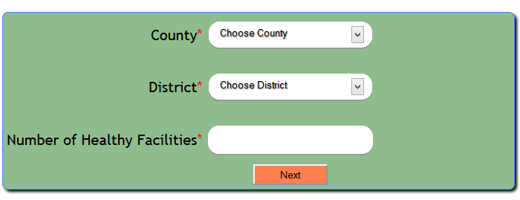
ADD HEALTH FACILITY
When this is clicked, the following page appears
N/B : The number of health facilities entered, determines the maximum number of health facilities that can be registered at once .
Click Here To Select a county
Click Here to select a district where all the healthy facilities you need to register belongs
Enter the number of health facilities you want to register now.
Click Here to move to the next page

Slide 10
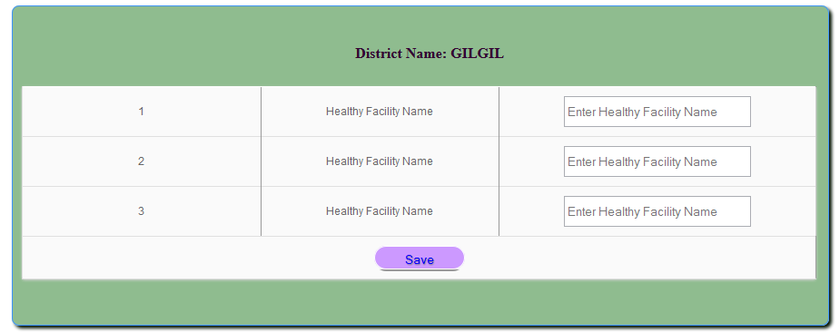
ADD HEALTH FACILITY
If 3 was entered as the number of health facilities, the following will appear.
This is the district that was selected from the previous page
Enter the healthy Facility Name Here..
This represents the number entered in the prior page.
Click Here to save the healthy facilities you have entered

Slide 11
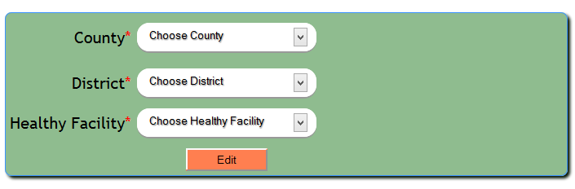
EDIT HEALTH FACILITY
Here you can edit an existing health facility’s details.
Choose County
Choose district
Choose the healthy facility you need to edit
Click here to move to the next page.

Slide 12
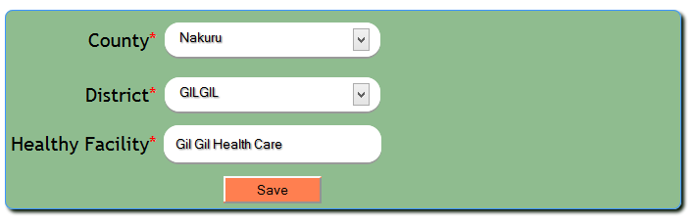
EDIT HEALTH FACILITY
All the details can be changed as shown in the figure below.
N/B : Change only the details that need to be changed. The values shown are default values.
Choose the correct county
Choose the correct district
Enter preferred health facility name.
Click here to save details

Slide 13
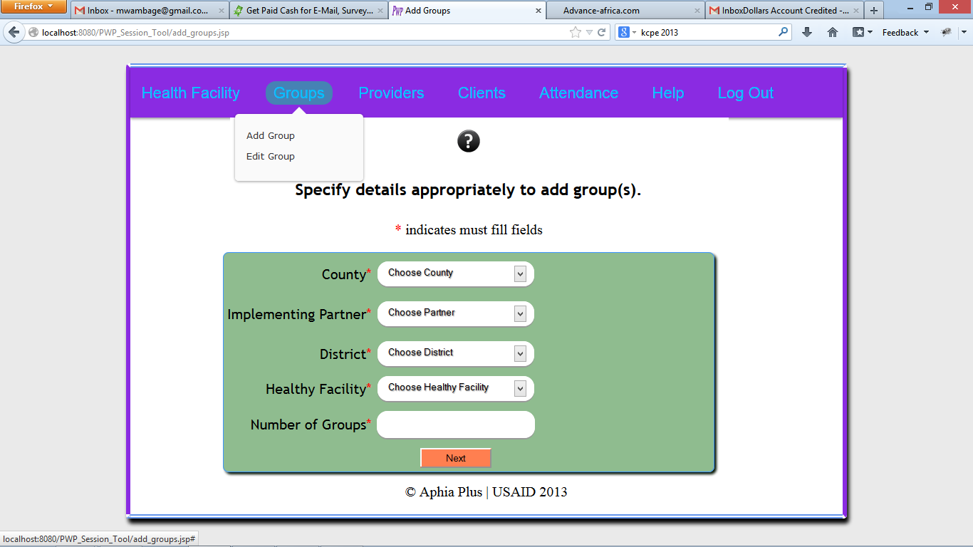
Groups
When a mouse is moved over, Group Button, a sub-menu shown below pops out. Click on Add Group to add new groups Or Click on Edit Group to edit Existing Group’s Details.
Move your mouse over this button for the pop up to appear
Click Here to add new Groups
Click here to edit existing group’s details.

Slide 14
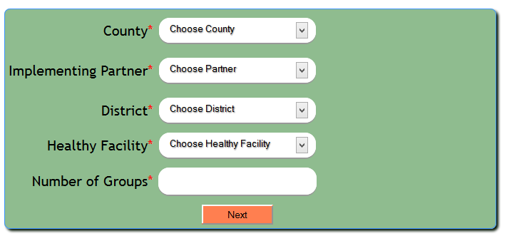
Add Groups
Provide the details needed and then press next.
Select the implementing Partner
Choose the county
Choose the district
Choose the nearest Healthy Facility
Enter the number of healthy facilities you need to register with the specifications selected above

Slide 15
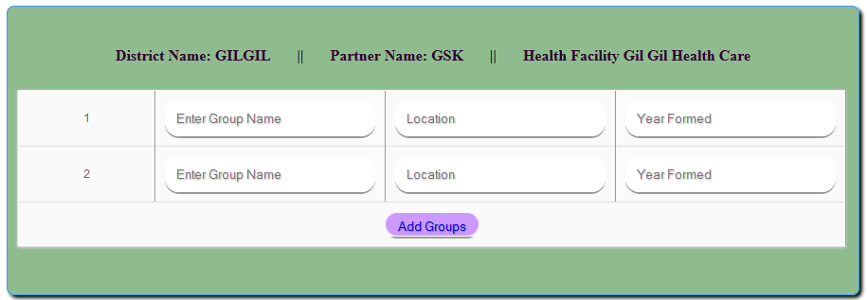
Add Groups
On Entering all the preferred details Press Add Groups button to add these groups to the System.
Details Selected from the previous page
Enter Name of a place where this group is located
Enter the year this group was formed
Enter Group Name Here
Press Here to Save this details

Slide 16
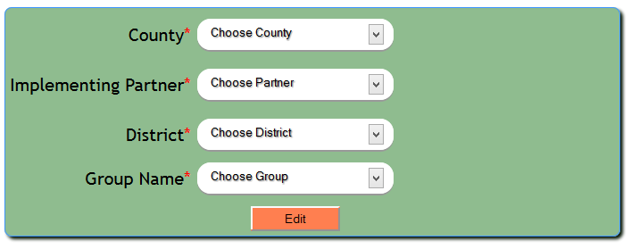
Edit GROUP
In This Sub Menu, A user can edit any details pertained to any group. This is achieved through, Filtering and selecting the group he/she need to edit its details as shown below
Select County Where the group was registered
Select the implementing partner
Choose the District
Choose the group which you want to edit its details
Press Here to move to the edit page

Slide 17
Edit GROUP
In This Sub Menu, A user can edit any details pertained to any group. This is achieved through, Filtering and selecting the group he/she need to edit its details as shown below
Select County Where the group was registered
Select the implementing partner
Choose the District
Choose the group which you want to edit its details
Press Here to move to the edit page

Slide 18
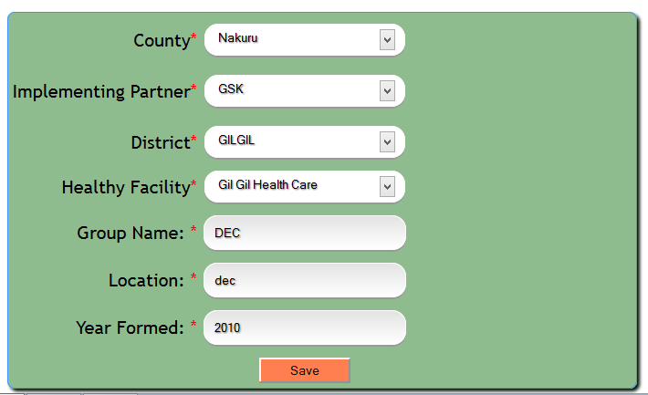
Edit GROUP
The details that appear here are the details that were selected or entered during group registration. You can change any of the preferred details
Select preferred county
Choose Correct District
Choose preferred Partner
Choose Correct Nearest Health Facility
Enter correct group name
Enter the correct group Location
Enter the correct year the group was formed
Click to save details

Slide 19
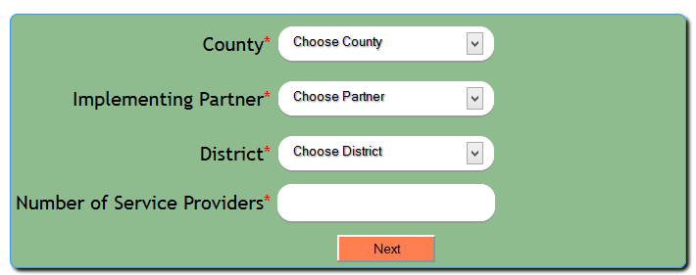
Add Providers
This Page gives a user capability to add service providers to the system. The service providers added will belong to the selected district and selected implementing partner.
Click Here to select county
Click Here to select implementing partner
Click Here to select district
Click Here to enter the number of service providers you want to register at once
Click here to move to the next page

Slide 20
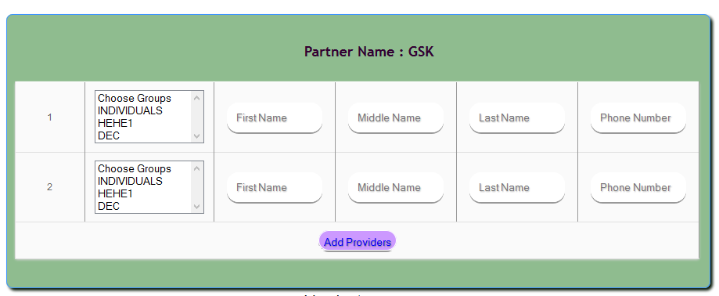
Add Providers
Enter service provider’s last name
Enter Service Provider’s middle name
Middle name is optional
Select Groups That are taught by this service provider.
Enter service provider’s first name
Click Here to save details
Enter service providers phone number

Slide 21
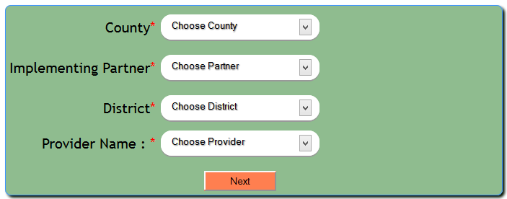
Edit PROVIDERS
In this page you are required to select all the detailed as entered when the service provider was being registered.
Select county
Select Implementing partner
Select District
Select the service provider whom you want to edit his/her details
Click here to move to the edit page.

Slide 22
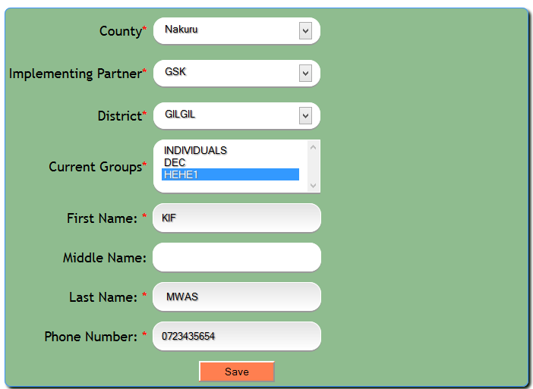
Edit PROVIDERS
In this page, edit only those details you want changed.
Choose the correct county
Choose the correct implementing partner
Choose the correct district
Choose the correct groups that are taught by this service provider, press and hold CTRL button to select more than one group.
Enter the right first name
Enter the correct last name
Enter the right middle name(this is optional)
Enter the correct phone number
Press Here to save the edited details.

Slide 23
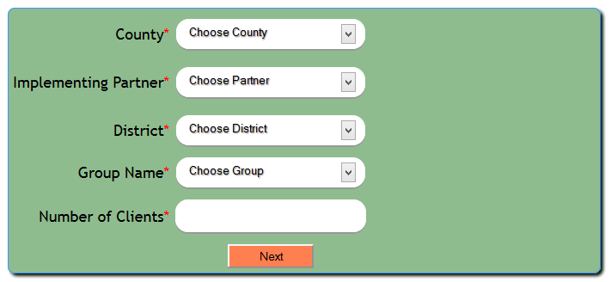
ADD CLIENTS
Within this page, the user will be able to add clients who belong to the same group or don’t belong to a group but attended all their session together.
N/B : INDIVIDUAL Clients who attended their sessions together must be also registered together.
Choose the group to which you need to register clients, if the clients don’t belong to any group, select INDIVIDUALS
Choose details appropriately
Enter the number of clients you need to register to the selected group
Click here to move to the registration page

Slide 24
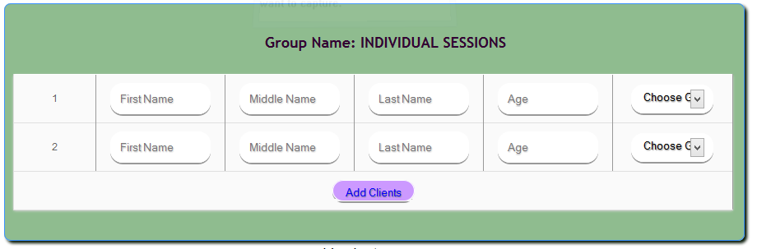
ADD CLIENTS
The Middle Name is optional, Enter all the details for all the clients and the click on the Add Clients Button.
Enter client’s first name
Choose client’s Gender
Enter clients middle name (optional)
Enter client’s last name
Enter client’s current age
Click to save details

Slide 25
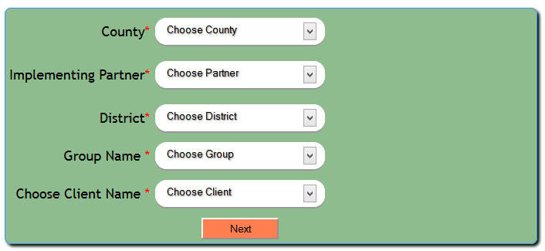
edit CLIENT
Select the details in the given order to edit client’s details. The details selected will help in choosing the client to edit his/her details.
Choose the client whom you want to edit his/her details
Click here to move to the client details edit page

Slide 26
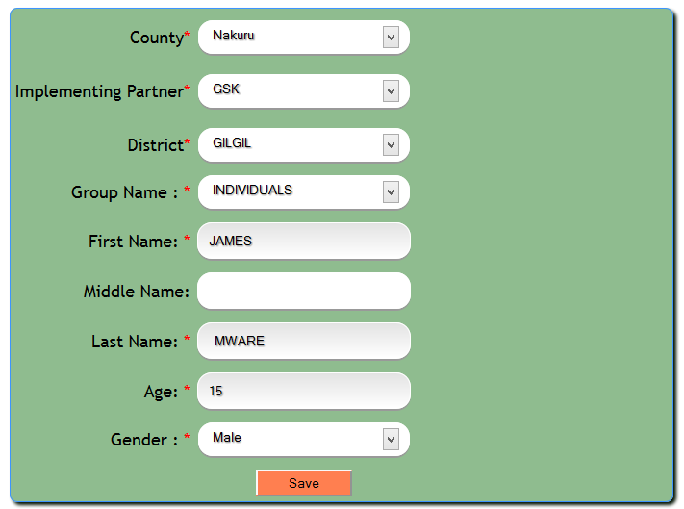
edit CLIENT
Edit any of the client details shown below.
Select any of this details if it was selected wrongly
You can choose to edit any of the following client details

Slide 27
Mark Attendance
Details are filtered as shown below and a group is selected whose attendance needs to be marked.
N/B : If you want to mark the attendance of clients who attended sessions together, just select INDIVIDUALS in the groups and then select one of the individuals whom you need to mark their attendance. If this client is selected, all the other clients who attended sessions together with this client, their details will be loaded for marking.

Slide 28
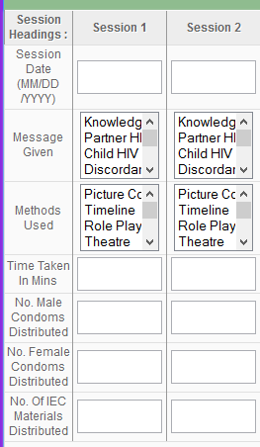

Mark Attendance – Add Sessions
There are 13 sessions in total, this page only displays 2 sessions for explanations purposes. Enter all details for 13 sessions
This row shows the sessions (1 to 13)
Click To Select Session Date
Press and Hold to Select 1 Or more messages given in this session
Press and hold CTRL Button to Select 1 or more methods used in this Session
Enter time taken for this session in minutes
Enter the number of male condoms distributed in this session
Enter the number of female condoms distributed in this session
Enter the number of IEC Materials Distributed in this session
After Entering all the details, press here to save and continue

Slide 29
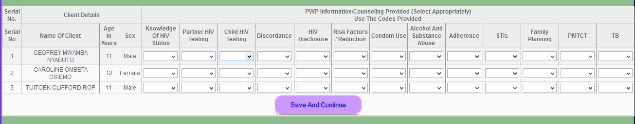
Mark Attendance – Information counseling provided
Select attendance appropriately for the 13 session messages as required and then save
Click on each of the drop downs to select PRESENT if the client attended that session teachings, ABSENT if he/she was absent and MAKE UP if the client attended the session teaching as a make up
This shows the client’s details
path
After Selecting all the details appropriately, click here to save and continue.

Slide 30
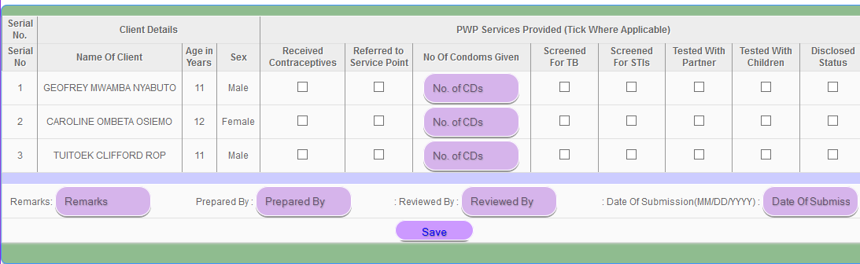
Mark Attendance – PWP SERVICES PROVIDED
Tick if the services were provided otherwise leave it
The Arrow Shows The order in which the information should be filled.
Tick If the services were provided else leave it
Enter the number of CDS distributed to each individual in all the 13 sessions

Slide 31
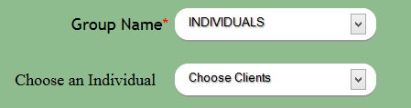
Edit Attendance – Filtering page
In this case, you select all the required details then Select Group and Press next, If clients attendance has been marked, you will be directed to the following page where you can edit Session Details.
N/B : To Edit Attendance of clients who attended sessions together but are not in a group, just select INDIVIDUALS in groups, a drop down will appear, Here you will be required to choose the Client whom you want to edit His Attendance details.

Slide 32
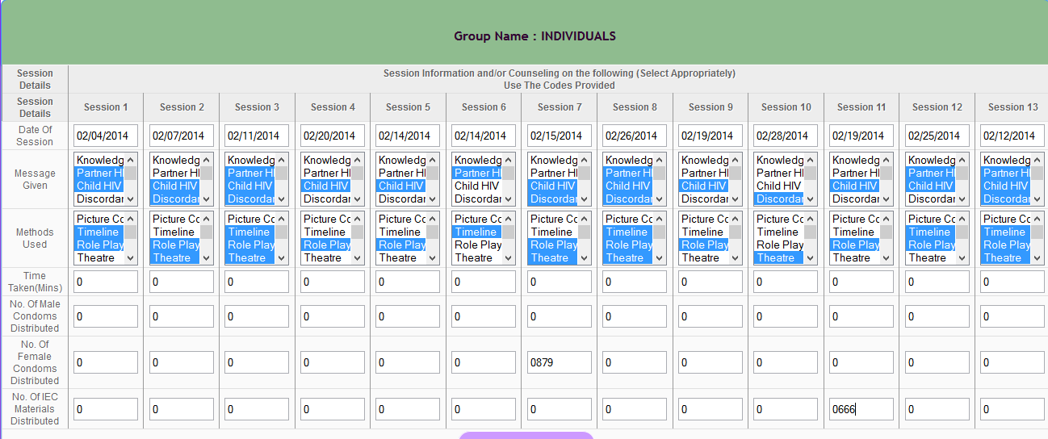
Edit Attendance – Edit Session Details
There are 13 sessions, these are minimized up to 6 for display purposes. You can change any of the details that was entered wrongly and then save the details by clicking save n continue

Slide 33
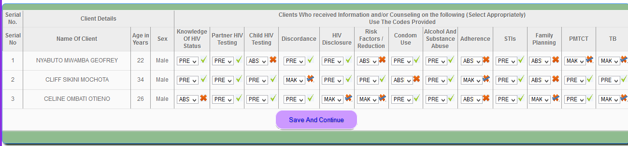
Edit Attendance – edit topics attended
The user can select the right attendance wherever he/she made a mistake and then click on save and continue. It can be present, absent or make up as appropriate.

Slide 34
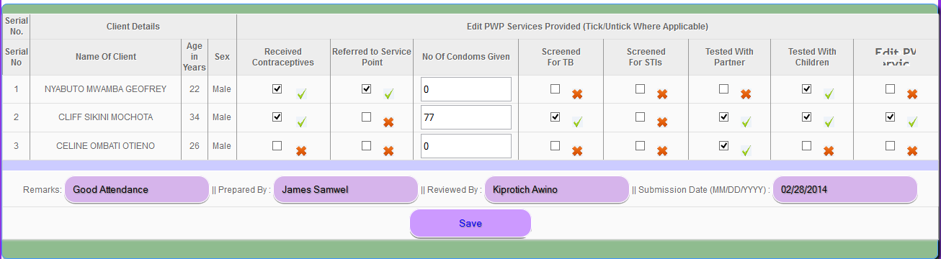
Edit Attendance – edit services provided
This page shows the services that were provided, tick for each user appropriately if the respective services were provided to that user. Also enter the number of condoms that were distributed to each individual.

Slide 35
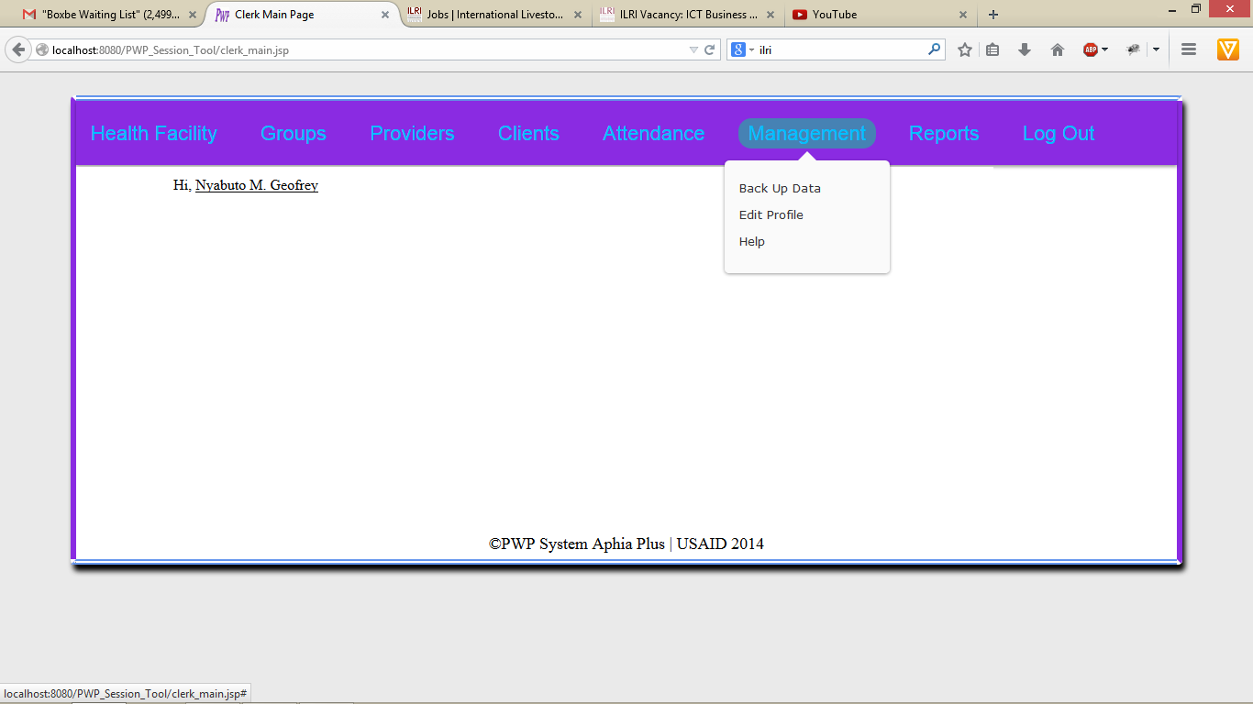
Management.
Within the management button, the user can be able to create back up, edit his/her details(Edit Profile.), or get help on the system usage.

Slide 36
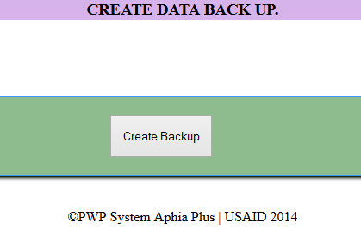
Management-create back up.
The user is supposed to click on this button so as he/ she can create a back up. When the user clicks on the button shown, a pop up of the back up appears. He /she saves the back up and forward it to the M&E Officer in charge of data at the county level.

Slide 37
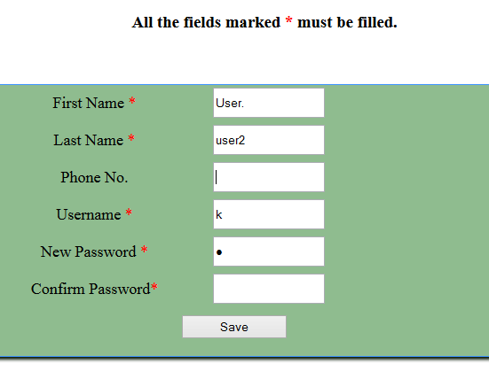
Management-edit profile.
Please ensure you provide the correct phone number. If the phone number is incorrect, the save button will be disabled.
This button is inactive until the whole of your phone number is correct or blank.

Slide 38
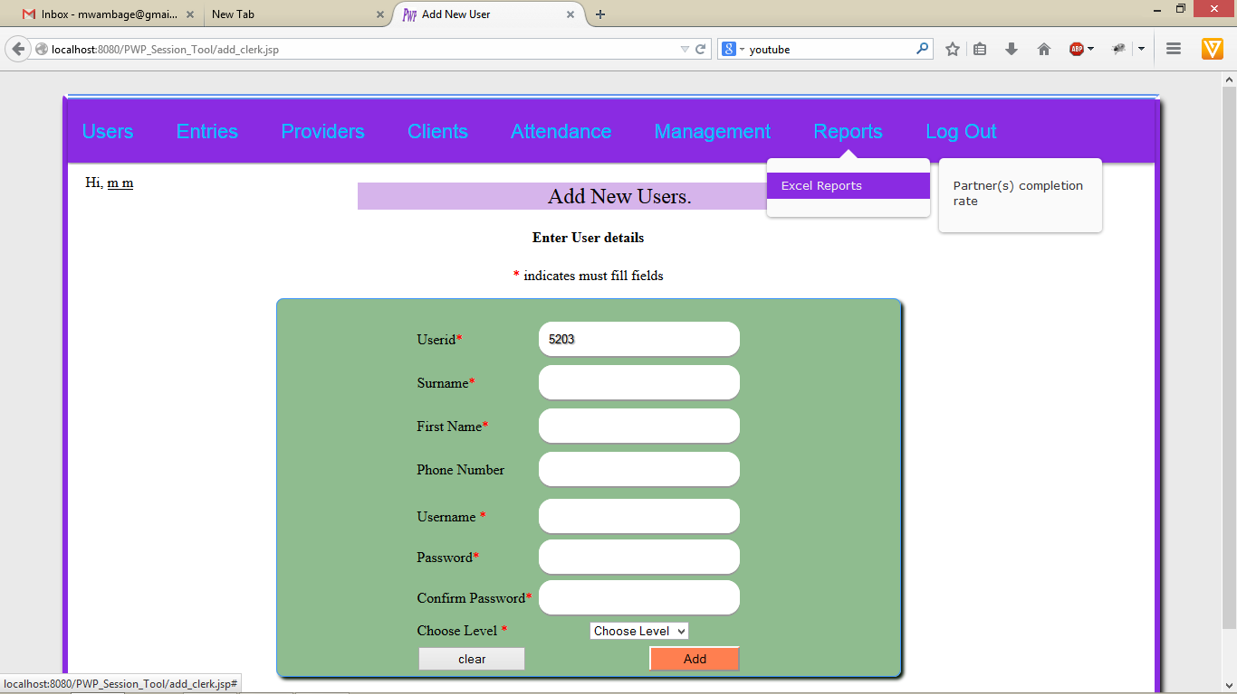
REPORTS.
All the system users are able to generate reports . Once a mouse is hovered over this link a sub menu appears from which the user can be able to click and generate a report.
This is how you can be able to access and generate a report.

Slide 39
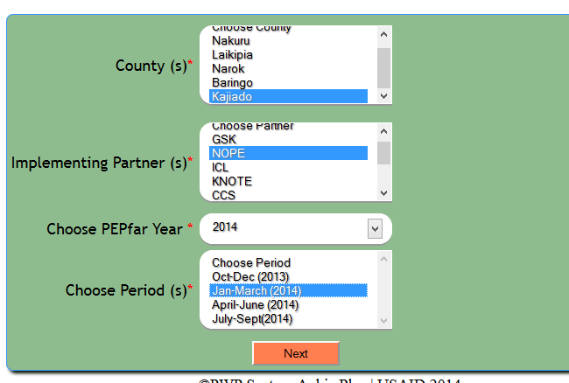
REPORTS-pwp completion rate (excel).
Select the details appropriately and then click on the next button.
By holding down the ctrl button, the user can be able to multi-select, counties, partners and periods.

Slide 40
MANAGEMENT - Help
By clicking on the Help button, the system is able to download a user guide which will guide you on how to use the system.

Slide 41
Administrator additional features.
If you are the system administrator, here arte the additional features to use:
Adding Users.
Merging data.
Sending data to head office via mail.

Slide 42
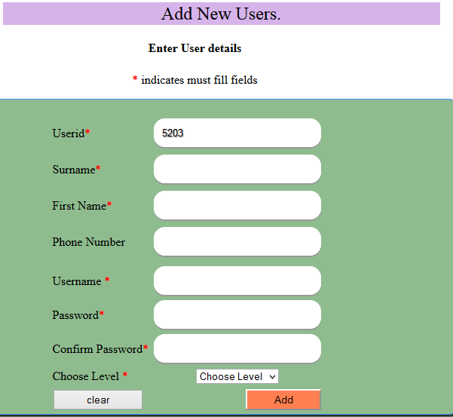
Administrator –add users.
The administrator has the rights to add other system users. This is achieved by clicking on the User button. Here is the adding users page.

Slide 43
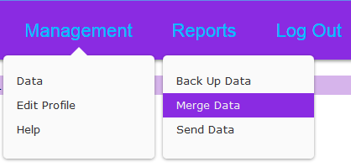
Administrator –Management.
When a mouse is moved over the management button and then over the data submenu, below sub-menus appear.
Within the data submenu the user is able to back up data, merge data and also send data.

Slide 44
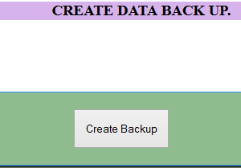
Administrator –Management-BACK UP DATA.
The M & E Officer is supposed to back up his/ her own data, if he/she was involved with any data entry as shown below.
On clicking the create back up button, a pop up of the created back up will appear. He/she needs to save this data to a location he knows. For this case the default is downloads.

Slide 45
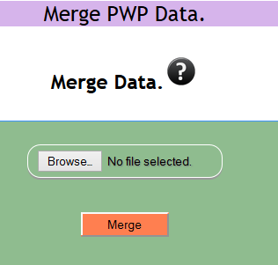
Administrator –Management-merge data.
The M&E Officer at the county level is supposed to collect all the data from the pwp users by creating the back up as shown. This collected back up includes his/her own back up.
On collecting the data, the officer will click on the merge data sub-button and the following page will appear.
Click here to select the file that you want to merge its data.

Slide 46
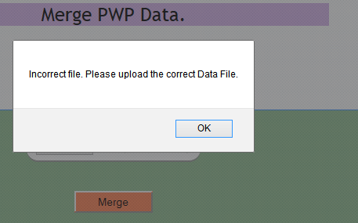
Merge data – Errors 1.
NOTE: The M&E Officer needs to select the correct database file i.e xxxxxxxxx.sql, this is very essential because if a wrong file is chosen, an error will appear as shown bellow.

Slide 47
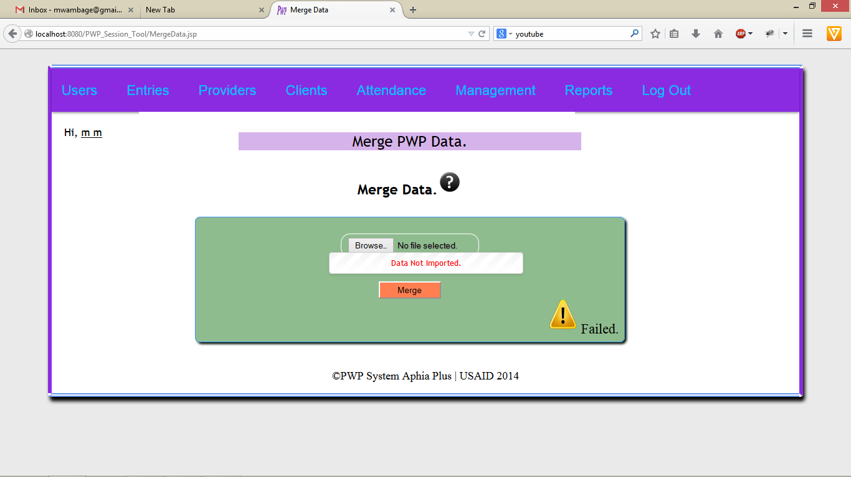
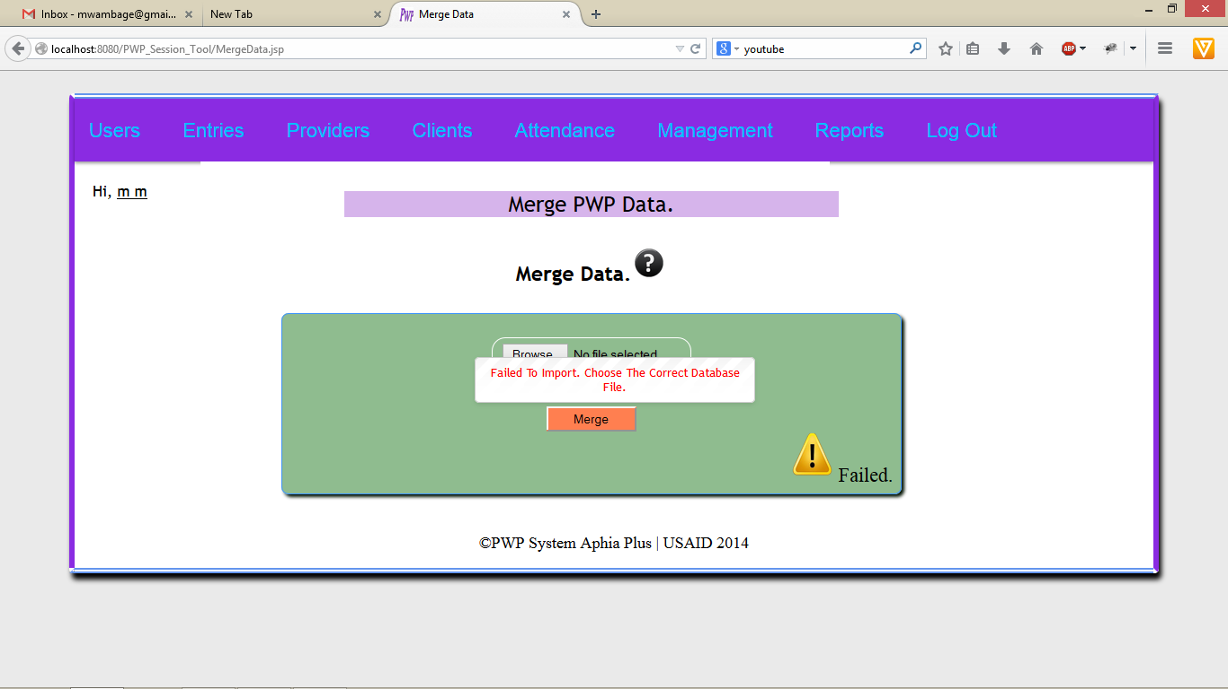
Merge data – Errors 2.
If the M&E Officer chooses a database file for a different database, an error show below will occur. And the database will not be merged.
Status
Status
Error
Error type,

Slide 48
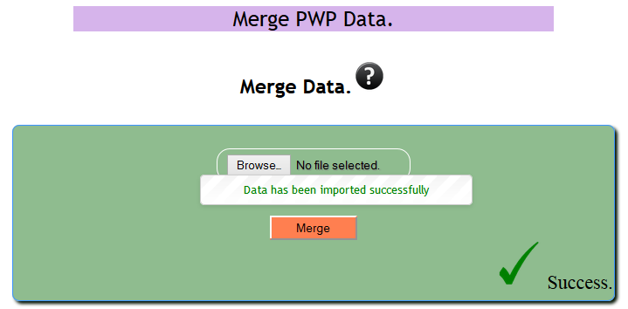
Merge data – success.
If all goes well and the database is merged to completion without any errors, a message shown below appears.
Success Message.
Status.

Slide 49
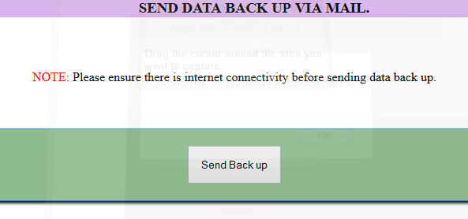
Send Data– success.
The M&E Officer is also supposed to send regular back up to the head office. This is achieved through clicking on Send Data and the page below appears.
By clicking here, the System will send directly the data back up via mail to the head office.

Slide 50
END.
END

